Slide 1
Neo4j Project Analyze Football Data Fall 2022-CS 673
Team: Pritam Channawar, Ari Perez, Manas Vani
Notes:
As our presentation graphics shows our analysis revolves around football matches

Slide 2

01
Problem Statement and reason why Graph Database is best fit
CONTENTS
02
Modeling of Graph Database, Node and Relationship Creation
03
Data Cleaning and Transformation
04
Aggregation Operations
05
Query on data and Conclusion
Notes:
Through the presentation we are going to cover these points

Slide 3
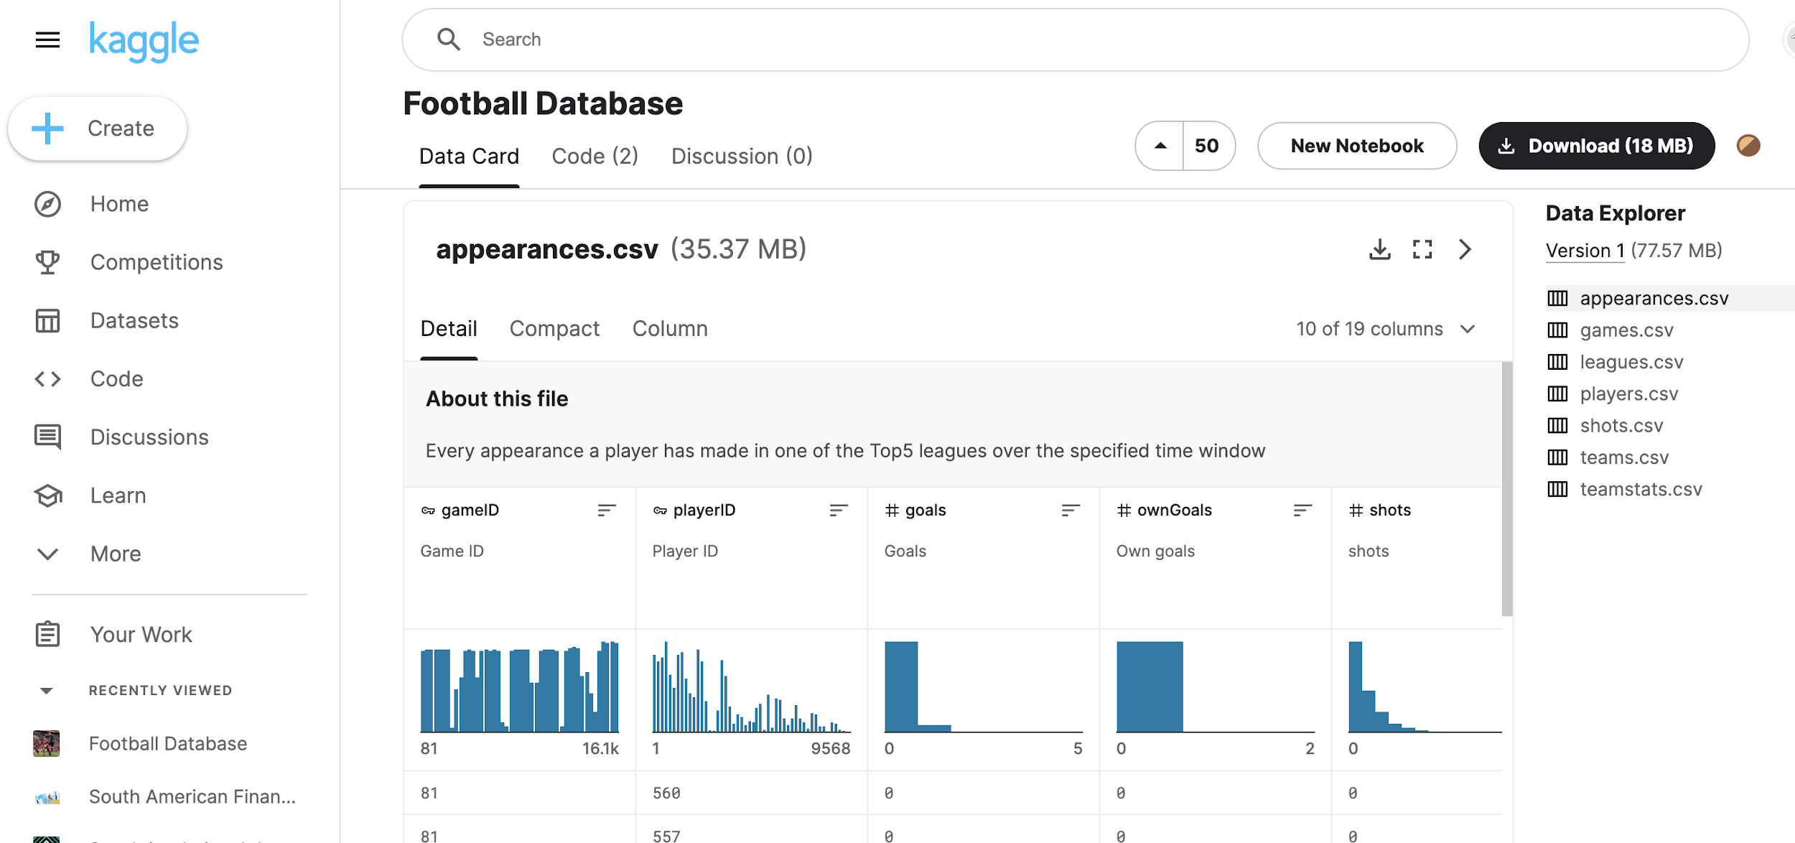
Problem Statement & Dataset
Create and analyze dataset containing football-related data covering the Top5 leagues in Europe from 2014-2020 using Neo4j.
Perform different queries to extract useful insights from given dataset and make future predictions.
Dataset- contains data in CSV file format with information of player’s appearances in game, games held in league, leagues, players details, shots played by players, teams and Game statistics.
https://www.kaggle.com/datasets/technika148/football-database
Notes:
The problem statement we chose is to create and analyze….

Slide 4
Why Graph Database is best fit for this Problem?
This dataset has a lot of information about players, game and over all leagues held, which makes the huge number of relations and a large network to analyze.
To understand how our different entities in a dataset are connected to each other, where the relationships in the data are just as important as the entities in the data, graph databases really offer an advantage.
With data relationships at their center, graphs are incredibly efficient when it comes to query speeds, even for deep and complex queries.
The Neo4j graph database allows you to connect your network, data center, and IT assets in order to get important insights into the relationships between different operations within your network.

Slide 5
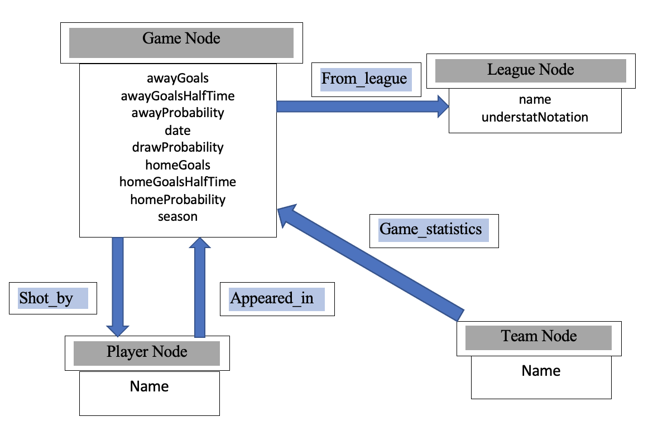
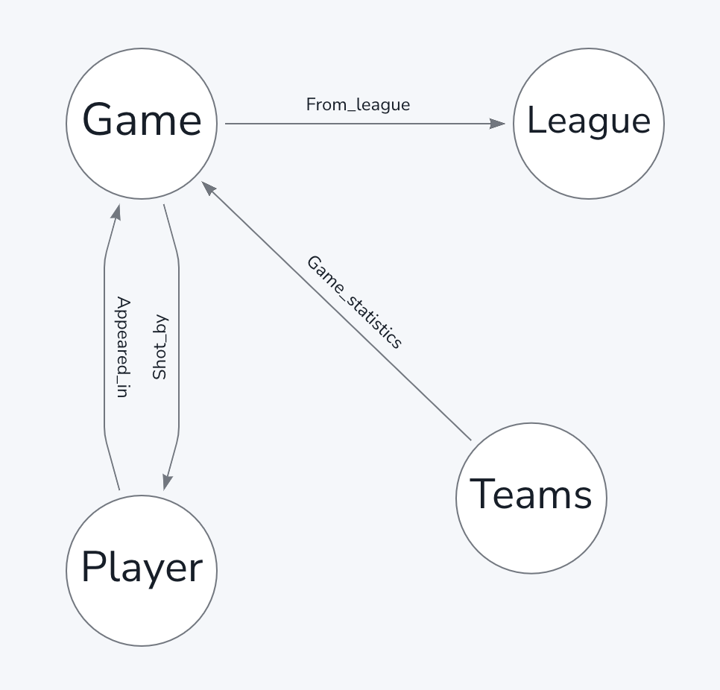
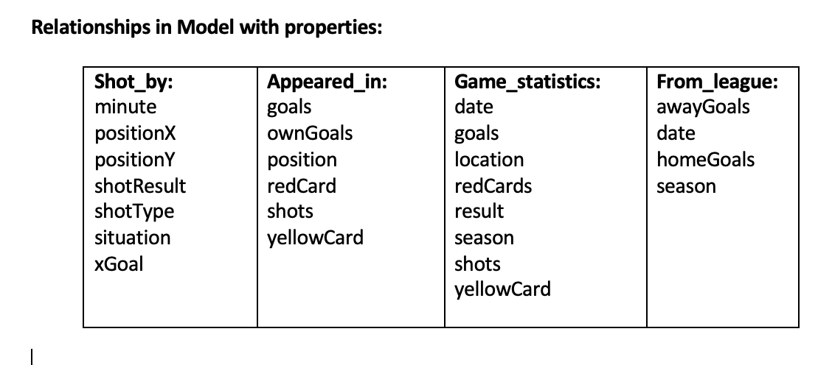
Graph Database modelling

Slide 6
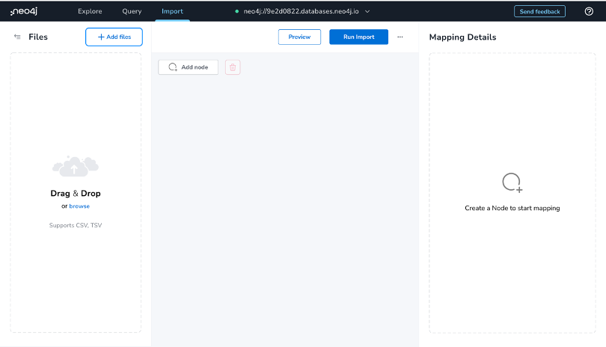
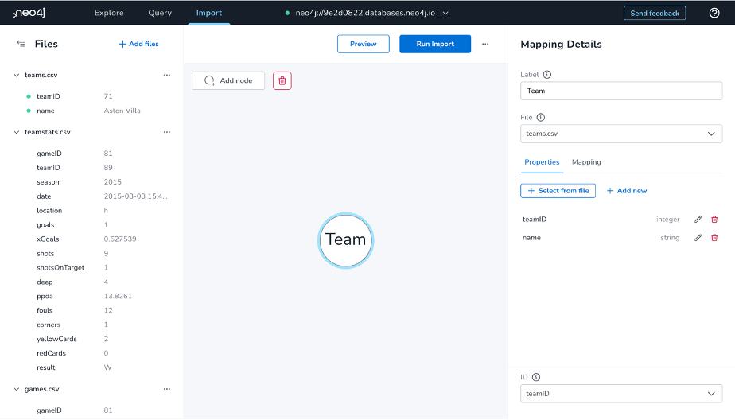
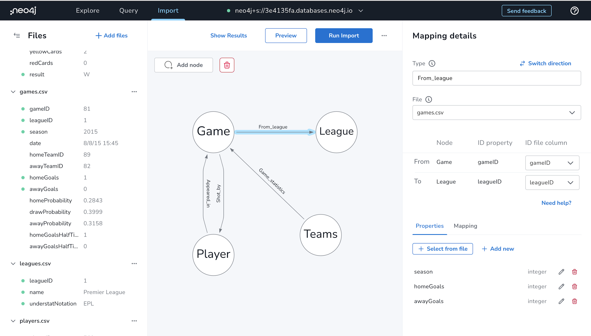
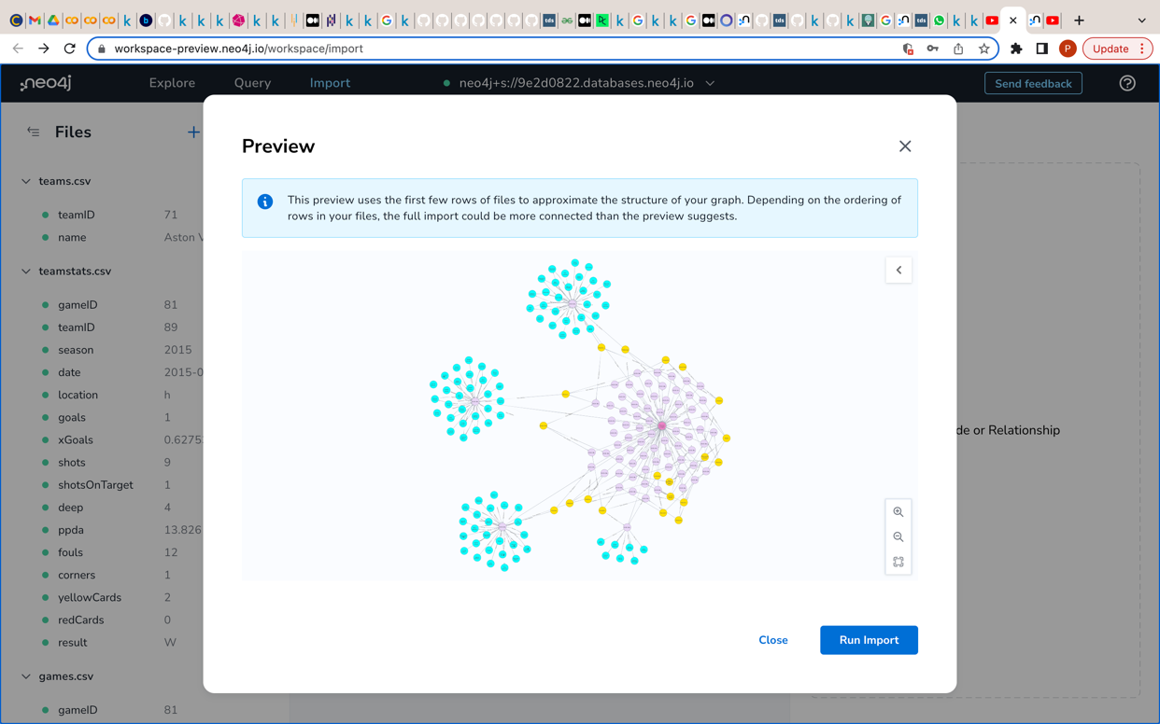
Create Node and Relationship
We are using Neo4j’s (Data Importer Tool) AuraDB instance to create nodes and relationships with constraints.
Notes:
Credential, URL, Create node, Relationships, Key, Parameters, Import graph

Slide 7
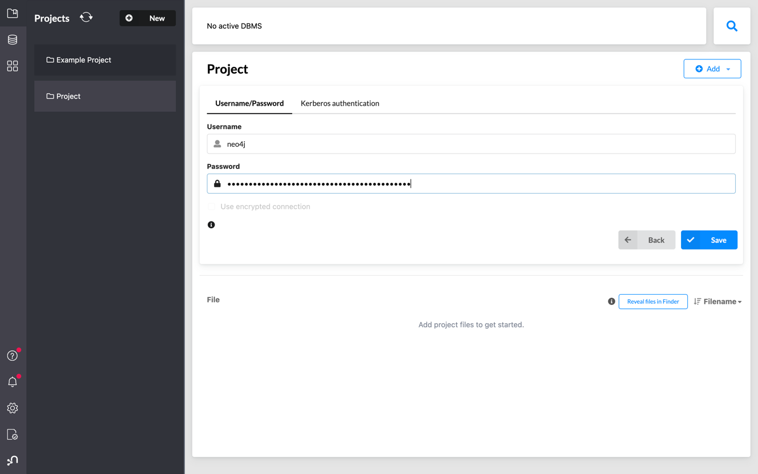
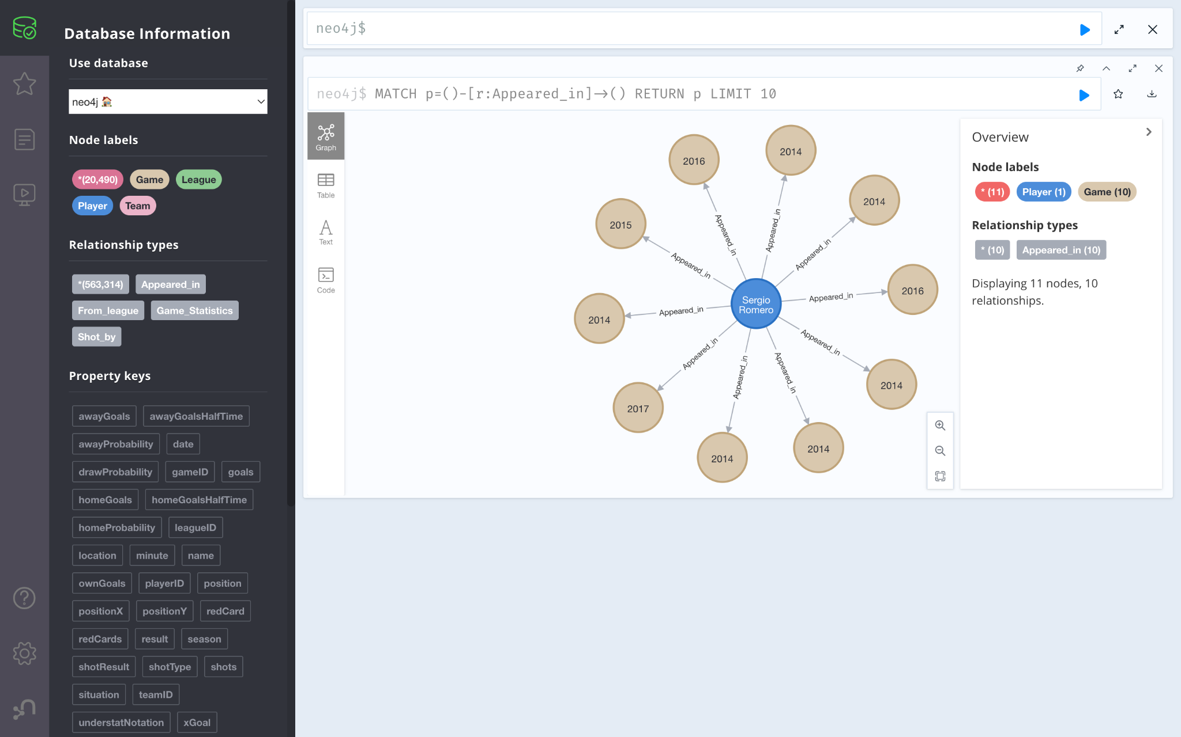
Connect Remote Instance on Neo4j Desktop
MATCH p=()-[r:Appeared_in]->() RETURN p LIMIT 10
Notes:
Neo4j desktop put instance credentials and start the project. Run basic query to check connections

Slide 8
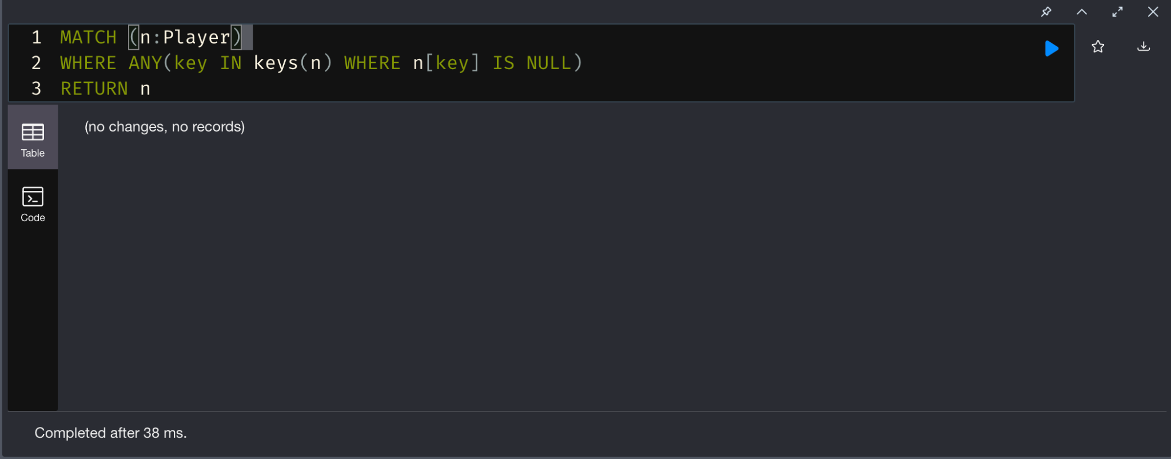
Data Cleaning
Checking for NULL values with keys function

Slide 9
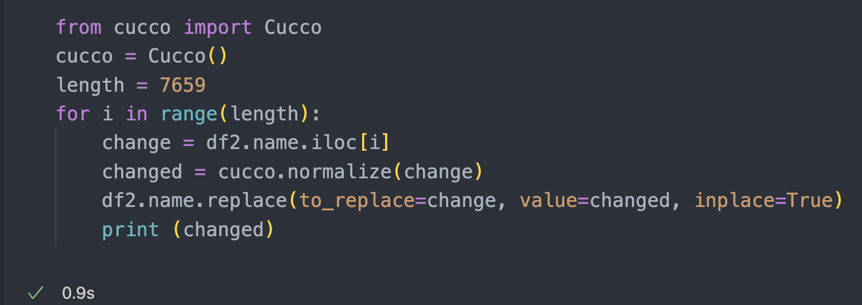
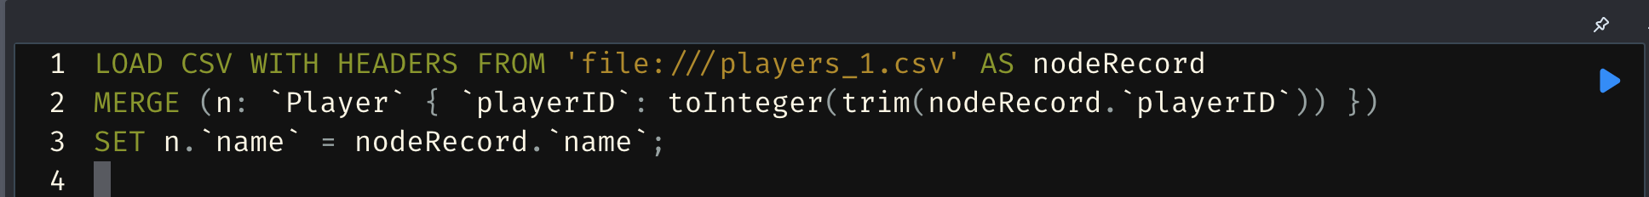
Data Transformation
Transforming the name of the players with accents. Property accent_name was the name in the dataset. To make the name legible and useful for queries, we transformed it by using python library Cucco.
We tried using Cypher to clean the name, but Neo4j was not able to read the accents. Used python to clean the name and then use Cypher to load the new names into the player nodes

Slide 10
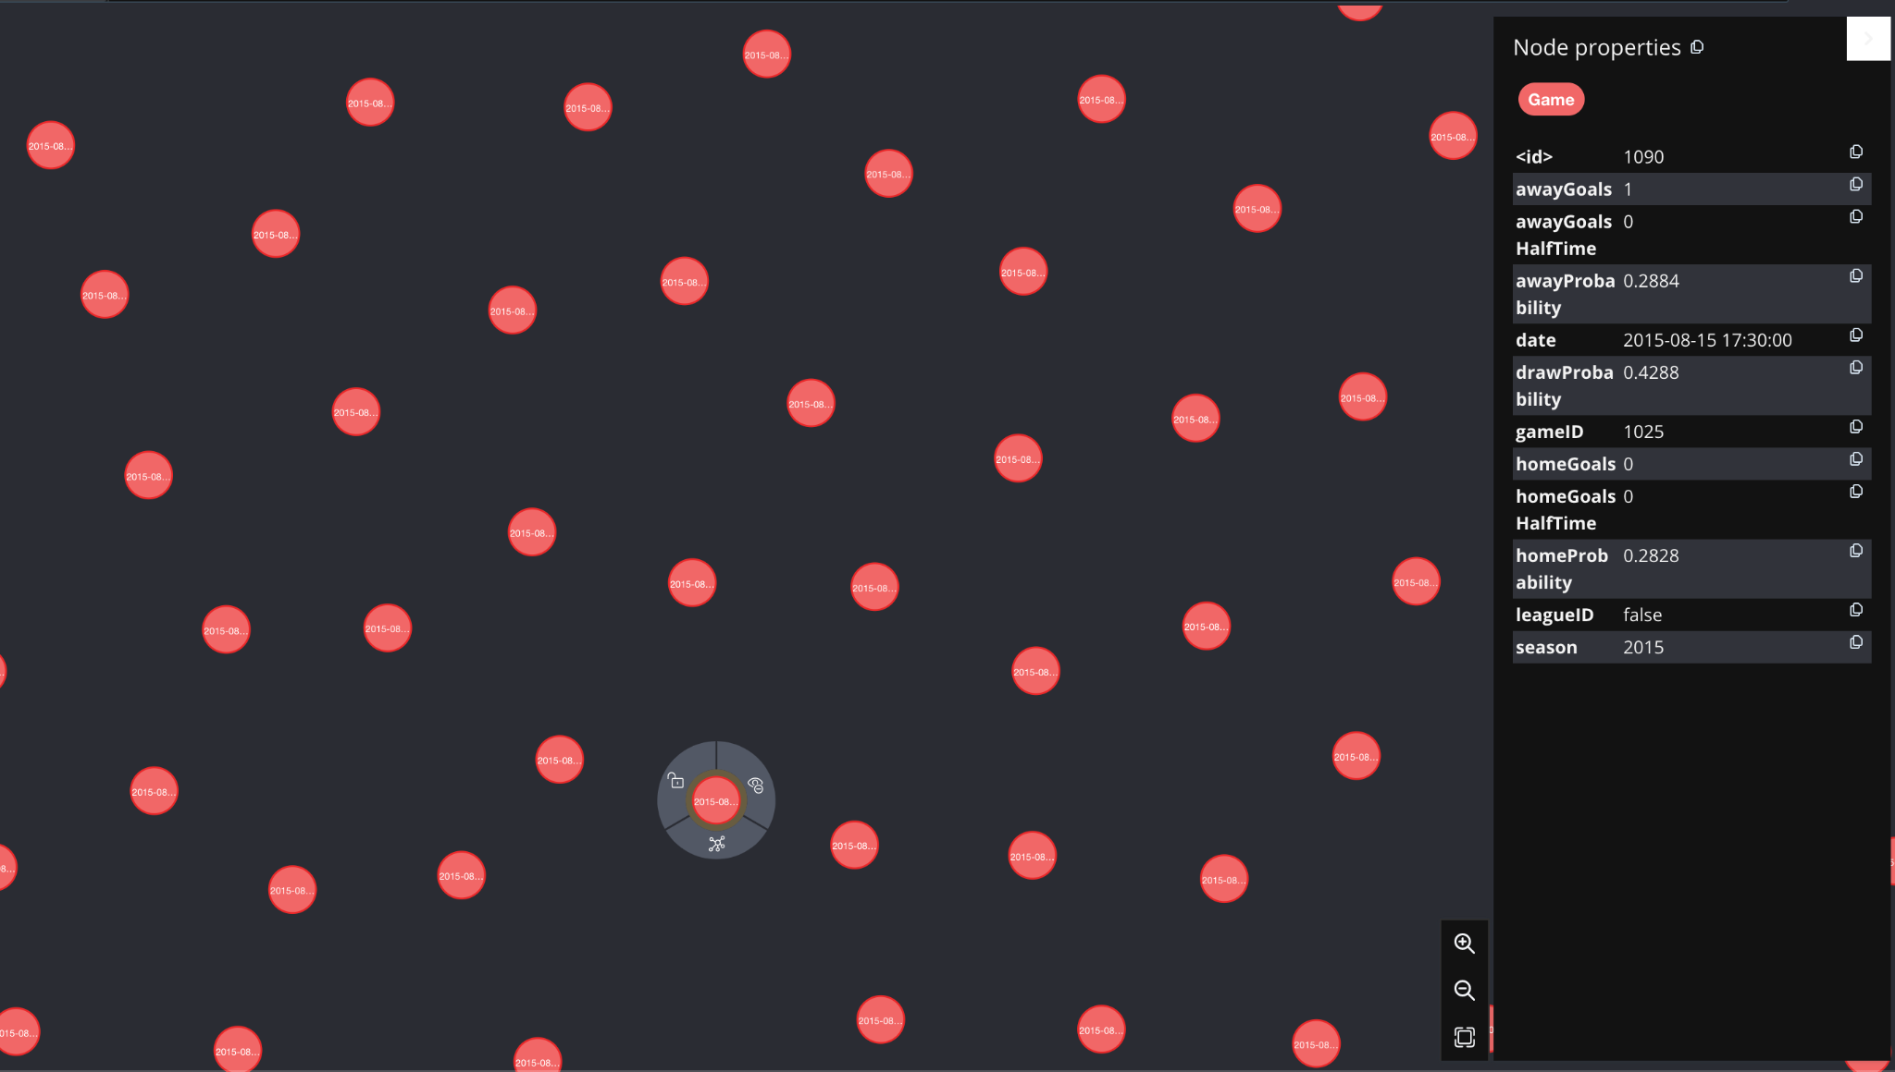
Aggregation Operations
Filtering the date to look for a specific game
MATCH (n:Game)
WHERE n.date CONTAINS "2015-08"//can be any date
RETURN n

Slide 11
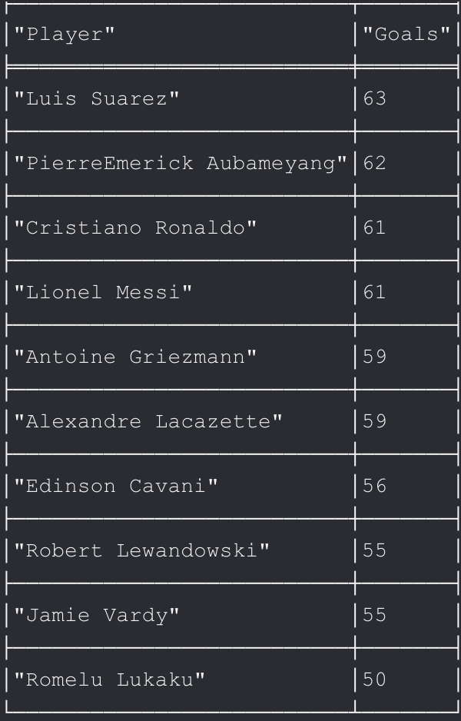
Aggregation Operations
Top 10 Goal Scorers
MATCH (player: Player) <-[rel: Shot_by]- ()
WHERE rel.shotResult = "Goal"
RETURN player.name as Player, count(rel) as Goals
ORDER BY Goals DESC
LIMIT 10

Slide 12
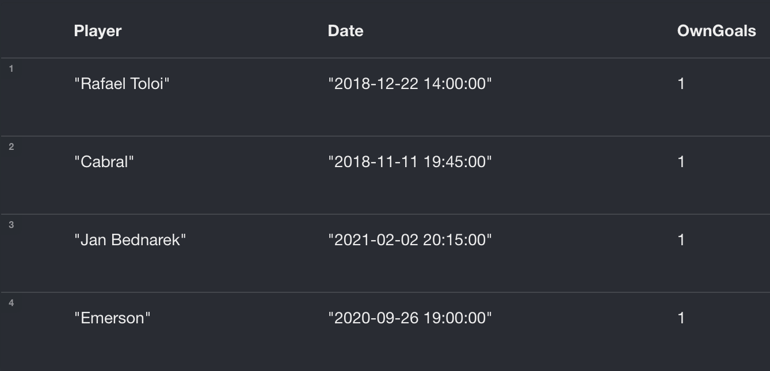
Aggregation Operations
All Players with Own Goal
AND Red Card in the same game
MATCH (player: Player) <-[shotBy: Shot_by]- (game: Game)
WHERE shotBy.shotResult = "OwnGoal"
WITH player, count(shotBy) as ownGoals, game.gameID as gameID
MATCH (player) -[a:Appeared_in]-> (game: Game{ gameID: gameID})
WHERE a.redCard = true
// Aggregating by Player and Date, no GROUP BY necessary in GRAPHQL
RETURN player.name as Player, game.date as Date, ownGoals as OwnGoals

Slide 13
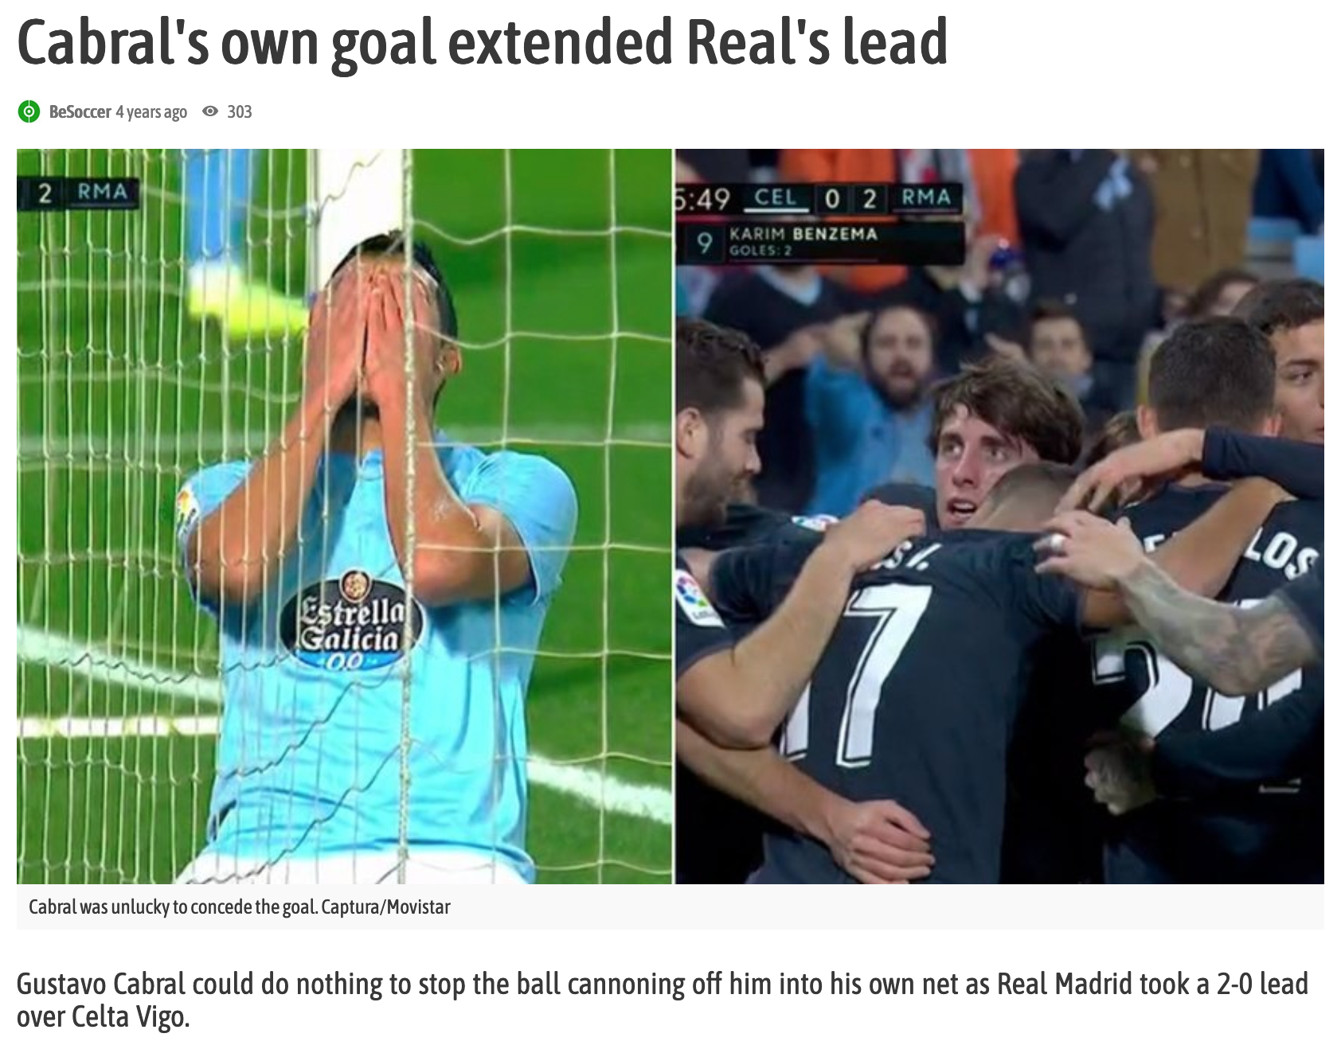
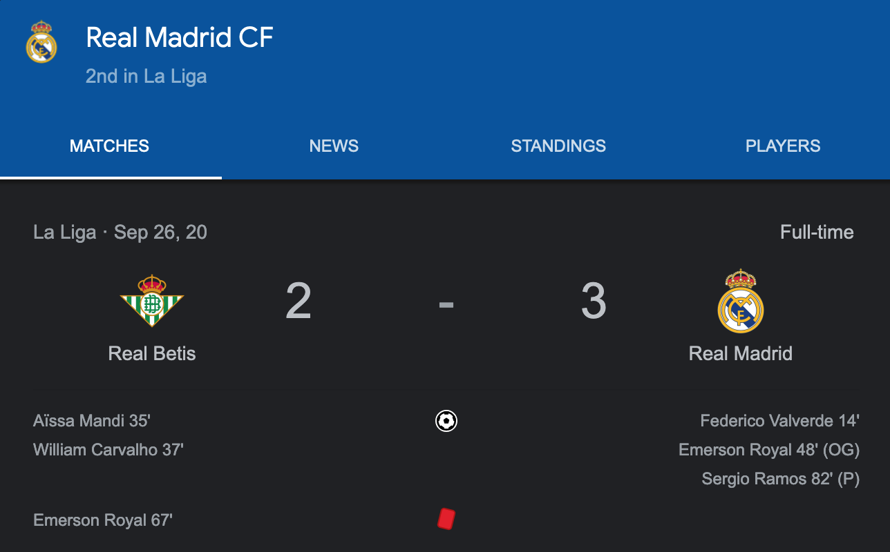
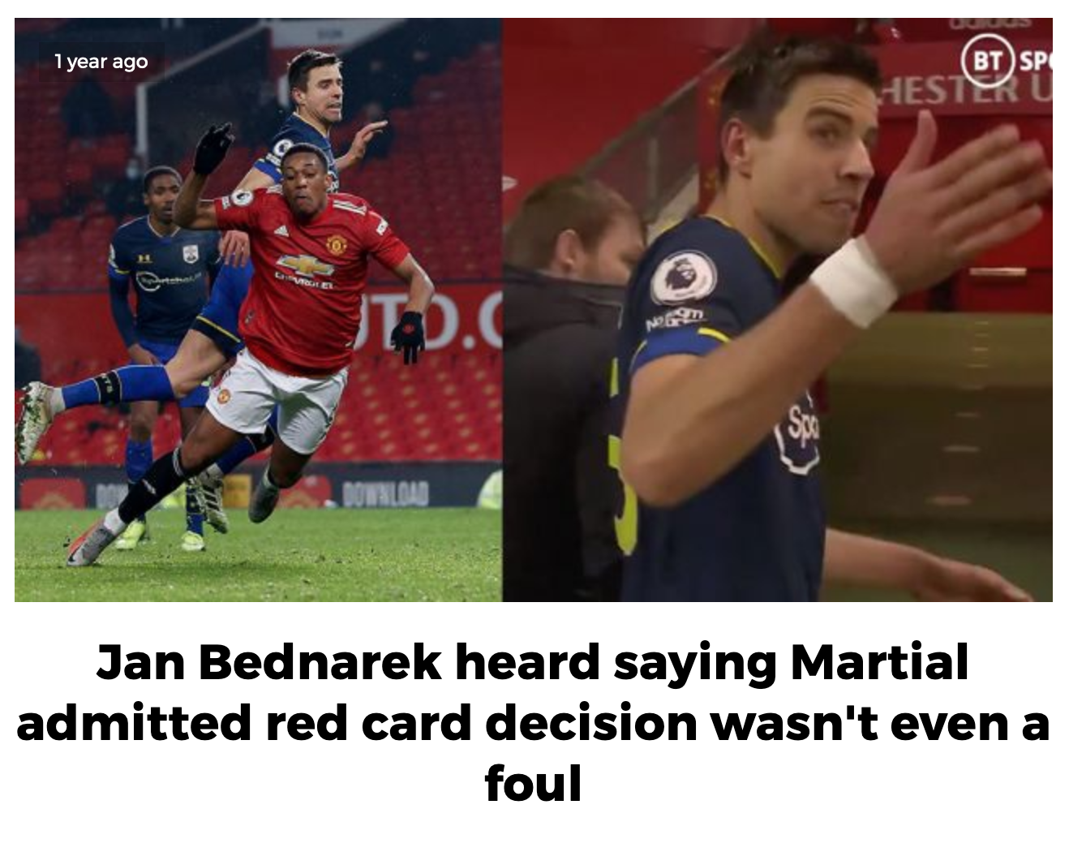
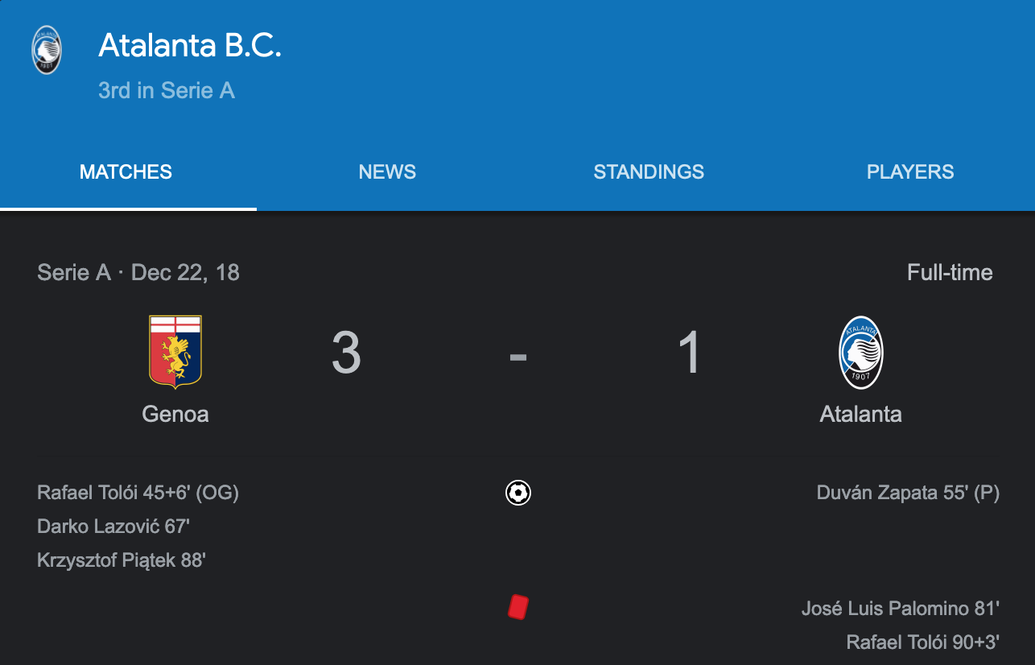
Aggregation Operations
😢

Slide 14
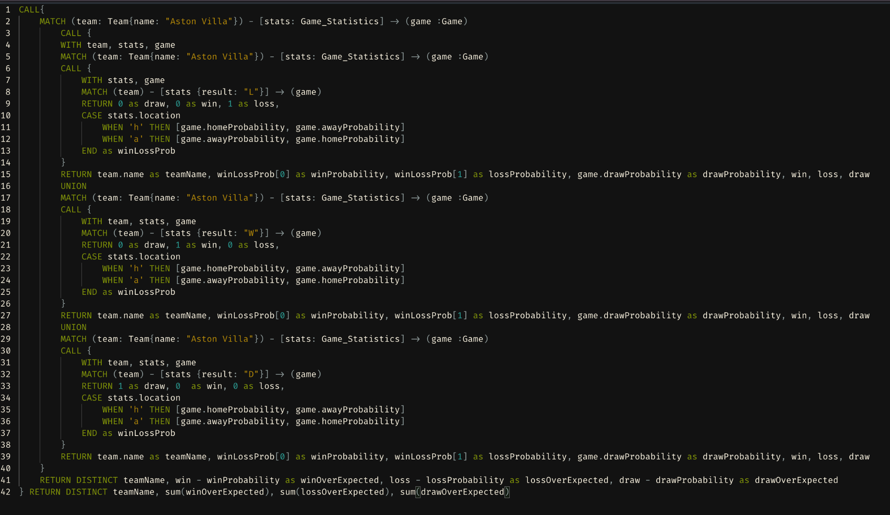
Aggregation Operations
Notes:
TRY TO SAY THIS BEFORE TURNING TO THE SLIDE: Ok so that was sad. Sorry to single those guys out, but, at the same time, we’re starting to see the power of these graphs.
TURN TO THE SLIDE: After messing around for a bit, we built this. (by the way, I know this is a massive query. We’re obviously beginners at working with GraphQL so not sure this was the most efficient way to do this, thus the massive query. Sorry about that. There’s a better way to get this data and as we work with it more we’ll see more but, even so, the results from this were super intuitive).
ANYWAY That being said… next, we wanted to turn our attention to attempting to get real, tangible data from this dataset. So this massive query is what we built to find out how good (or bad) the football team Aston Villa performed versus their expected outcomes. What this query does is it adds up all their wins, losses and draws, and subtract them from their expected wins, losses and draws, respectively…

Slide 15
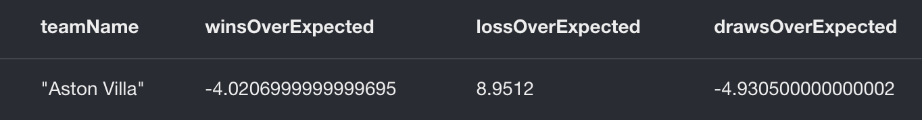
Aggregation Operations
Expected versus Actual Results
query on next slide
Notes:
And this is what we got. So, to explain this a bit, the “winsOverExpected” column says that they got -4 more wins than they were expected to get. In plain English, essentially they were expected to have 4 more wins in the games they played in the dataset. Moving to “lossOverExpected”, they lost almost 9 more games than they were expected to and they finally, in “drawsOverExpected” they had 4 less draws than they were expected to. Basically, these guys didn’t play very well. At least compared to their expectations.
Anecdotally we wanted to take this a step further and see which players might’ve been on this team at certain times and compare them with other players on other teams. Our dataset was a bit messed up so we couldn’t do that but it follows that being able to query those players could easily show which players might be under/over valued.

Slide 16
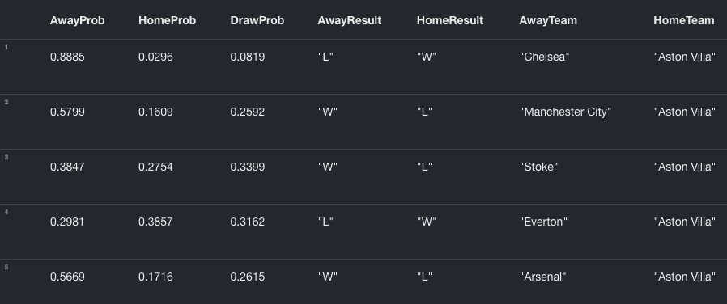
Queries on Data
Results by Game
MATCH (game: Game) <- [awayStats: Game_Statistics {location: 'a'}] - (awayTeam: Team)
MATCH (game: Game) <- [homeStats: Game_Statistics {location: 'h'}] - (homeTeam: Team)
RETURN game.awayProbability as AwayProb, game.homeProbability as HomeProb, game.drawProbability as DrawProb,
awayStats.result as AwayResult, homeStats.result as HomeResult, awayTeam.name as AwayTeam, homeTeam.name as HomeTeam
LIMIT 5
Notes:
Moving on to queries. So this was a query that we built while attempting to get the data we just showed and, indeed, part of this eventually became a subquery for the aggregation on the last slide. But tables are boring. The real power of graphs is visually being able to see relationships like you can’t in a typical RDBMS…

Slide 17
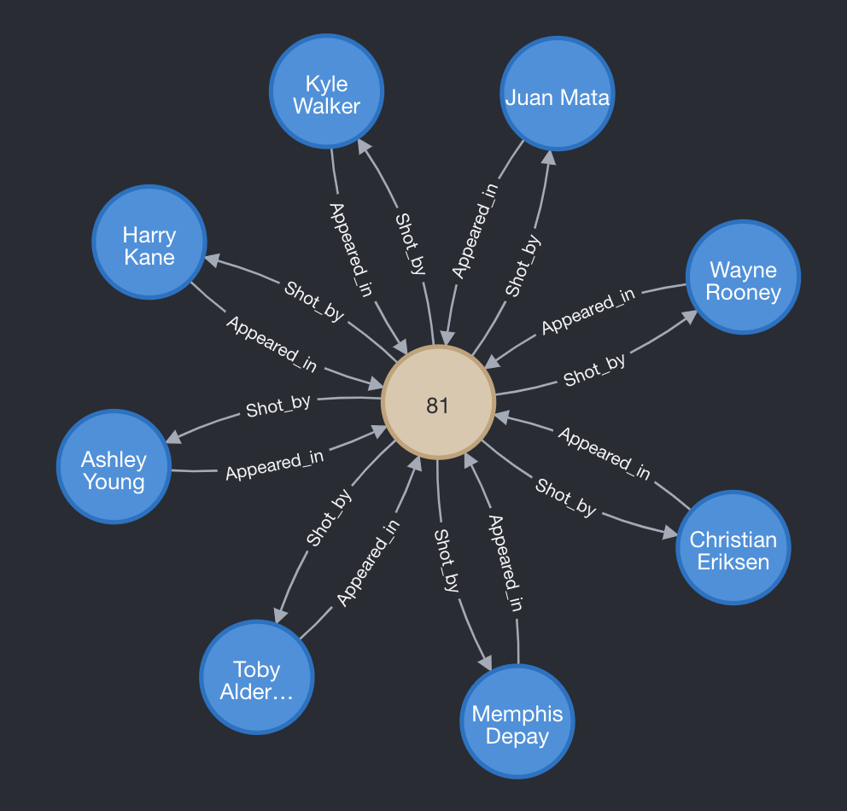
Queries on Data
Players with any Relationship to a Game
MATCH (player: Player) <-[rel1]- (game: Game)
MATCH (player: Player) -[rel2]-> (game)
WHERE game.gameID = 81
RETURN player, rel1, rel2, game
Notes:
So we randomly chose this game, game 81. It occured August 8, 2015 and it was a match between Manchester United and Tottenham Hotspur.
We were trying to gather all of the relationships between a player and that game.
We see that the 2 relationships between players and games are players who appeared in a game and those who took a shot in a game. This query seems is a little off, though. Seems like not enough players (in football there are 11 players per side) and every player that was in the game took a shot ? That can’t be right. Let’s fix it.

Slide 18
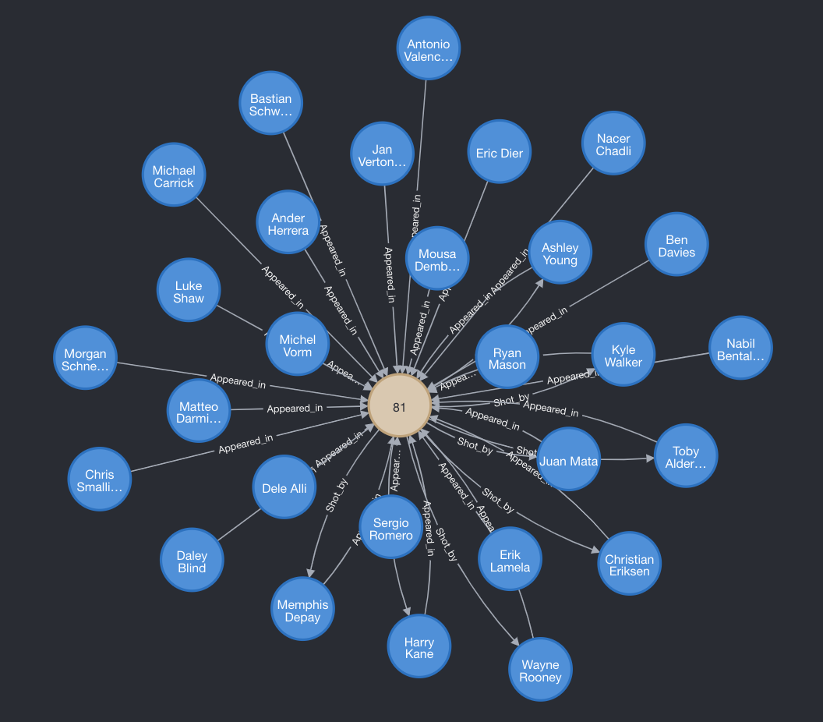
Queries on Data
Which Players Appeared In OR Took Shot
MATCH (player: Player) <-[rel1]- (game: Game)
MATCH (player2: Player) -[rel2]-> (game)
WHERE game.gameID = 81
RETURN player, player2, rel1, rel2, game
Notes:
After separating the players in this query, we get this much more informative view. In the first query, we have the player variable be the same in both MATCH statements. Here, by separating the two player variables into player1 and player2, we can now show all players played in the game or took a shot. What’s nice is that we see it together.

Slide 19
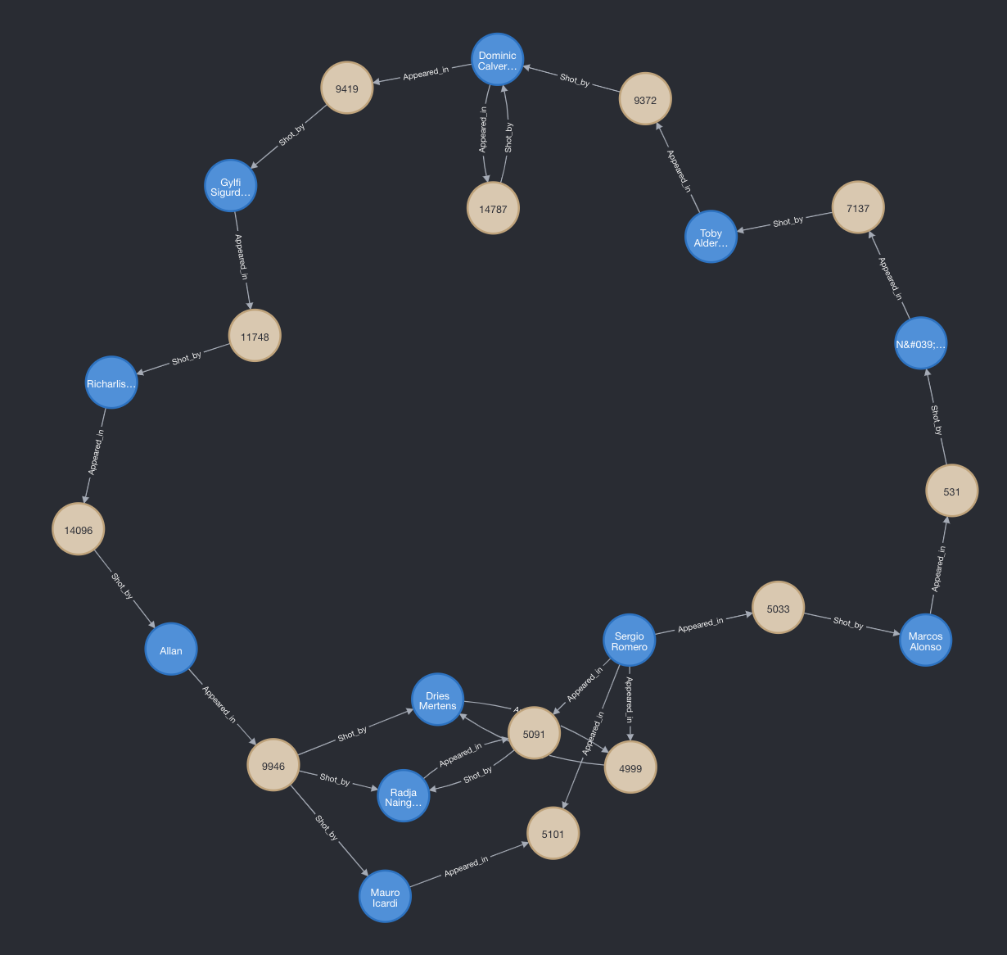
Queries on Data
Paths and Loops 🔁
MATCH path = (p:Player)-[*3..20]-(p)
RETURN path
LIMIT 5
Notes:
Another powerful thing about Graphs, and something that we think would be very difficult, if not impossible to see with other relational databases, is the ability to see relationships via multiple hops. Here, this query is showing us how different players are related to each other via a path of 3 to 20 hops. This, to us, is one of the most powerful elements of Graph databases. This Graph is limited to 5 results, but when we push it higher, say to 200…

Slide 20
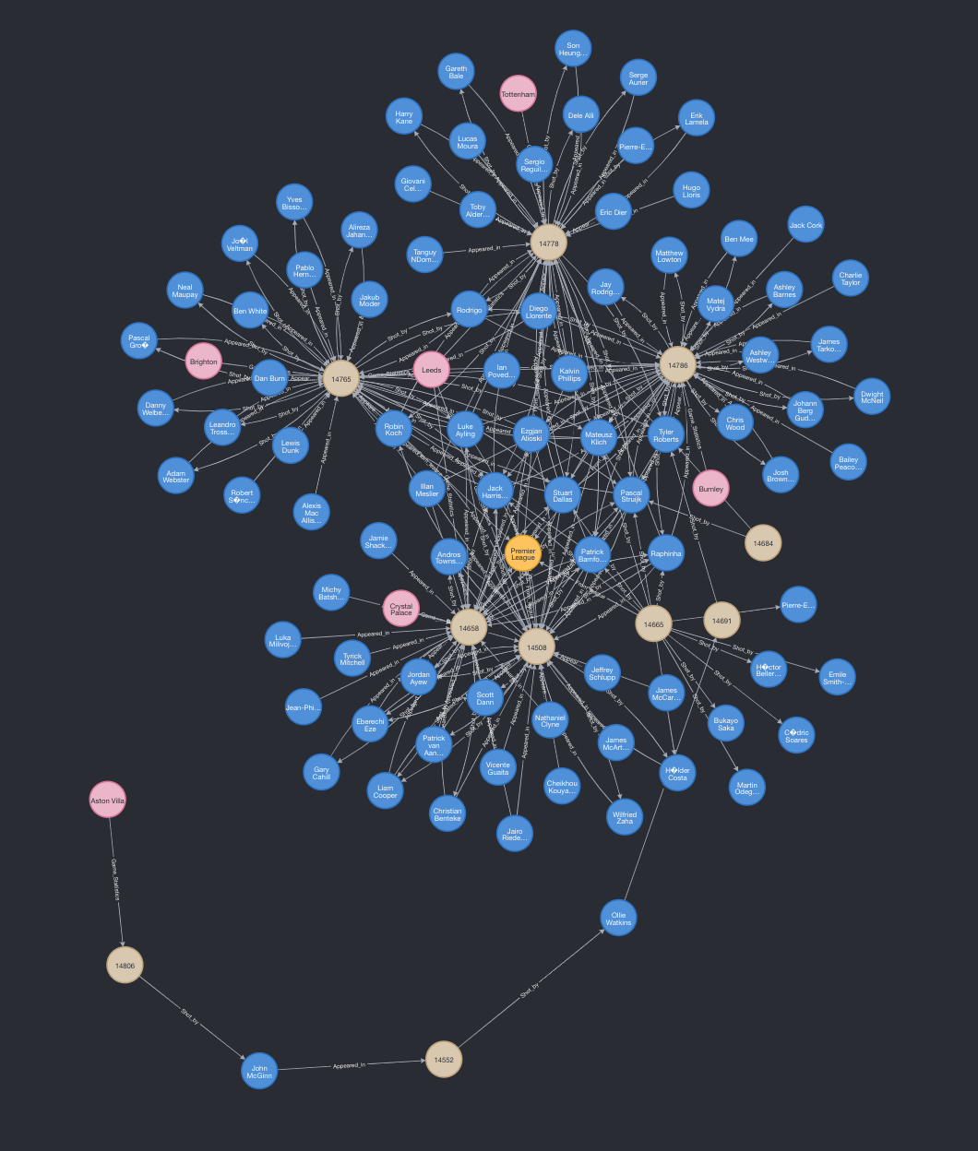
Conclusion
Notes:
We get this ! This is amazing. All the players, games, leagues, teams… we can really see how they come together. With the data graphed this way, like we mentioned with the aggregate query, we can easily see what players are having a real impact and which may be overvalued.
Our biggest takeback is that, although it takes some getting used to, there is very real power in Graph Databases. Having real information about not only that entities are connected, but HOW they’re connected (via relationships) opens up completely different ways of analyzing data. We think it reflects the real world much more accurately. Something like this would be nearly impossible to replicate on a typical RDBMS. Even in the little time we had with our data we found we were able to glean very compelling information due to this structure. So yea, Graphs are pretty awesome !

Slide 21
THANK YOU

